Slide 1
SGYO – Yount Elevator Addition
WPVAR18-0007
December 6, 2018
When we last met, you asked that we:
Provide a slope analysis map
Work with the US Forest Service to relieve their concerns
Obtain written confirmation from TRPA that an elevator addition on the south side would exceed TRPA allowable height
Investigate stair lift as an option
Consider a smaller elevator

Slide 2
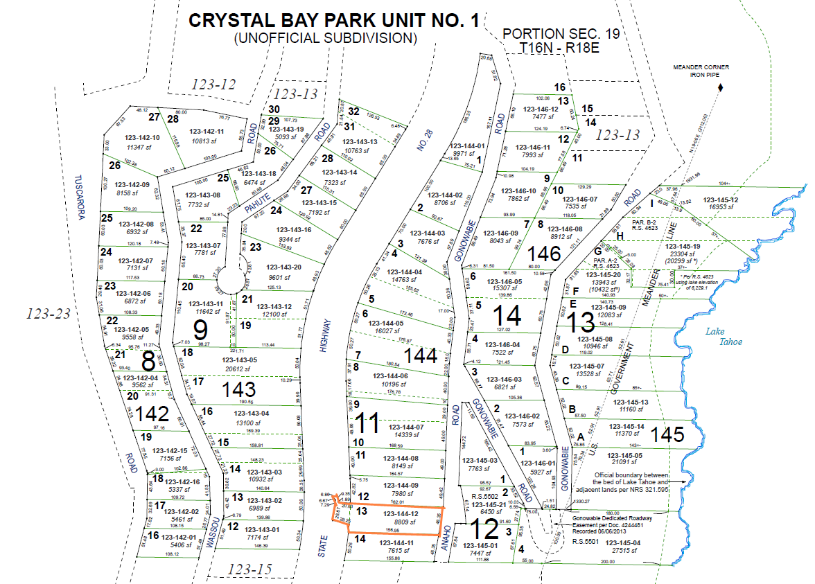

Slide 3
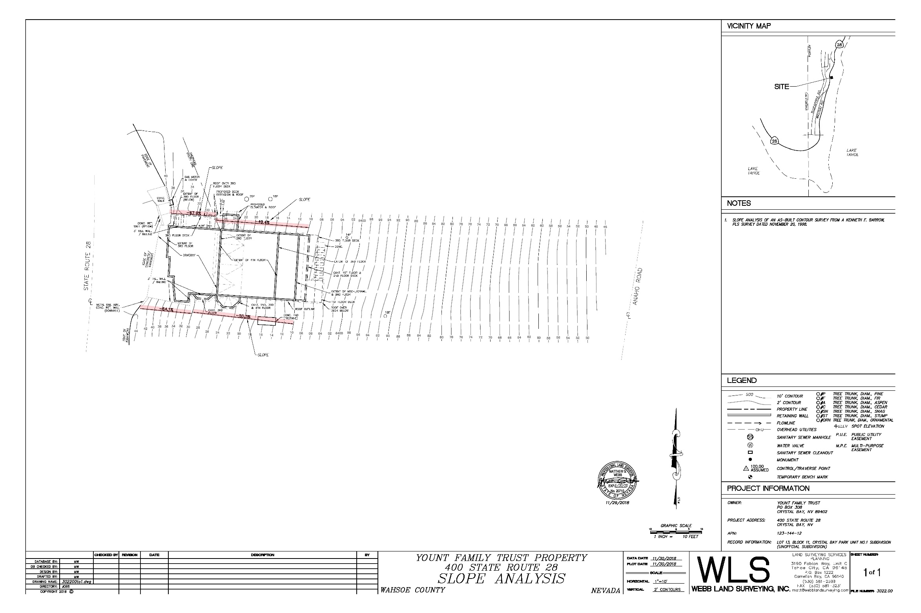
Full slope analysis map prepared by Webb Land Surveying, Inc.:

Slide 4
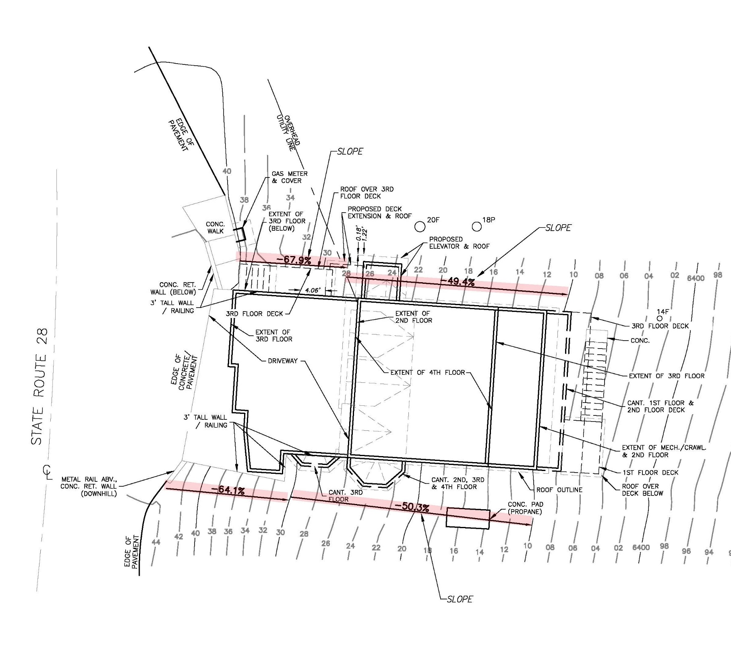
Zoomed in snapshot of slope analysis map:

Slide 5
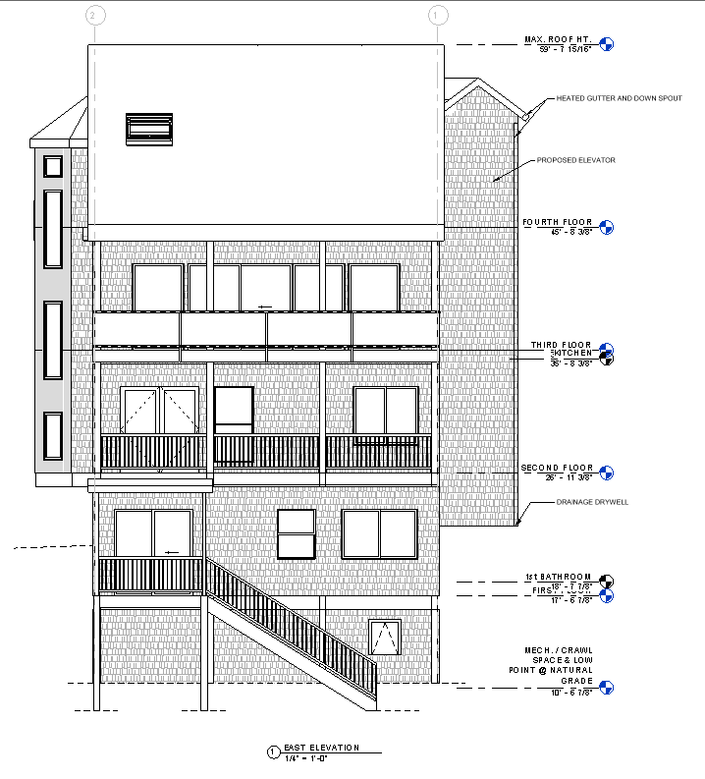
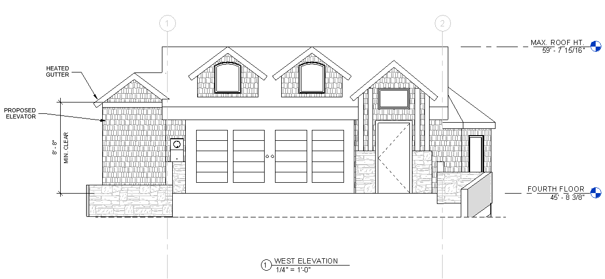

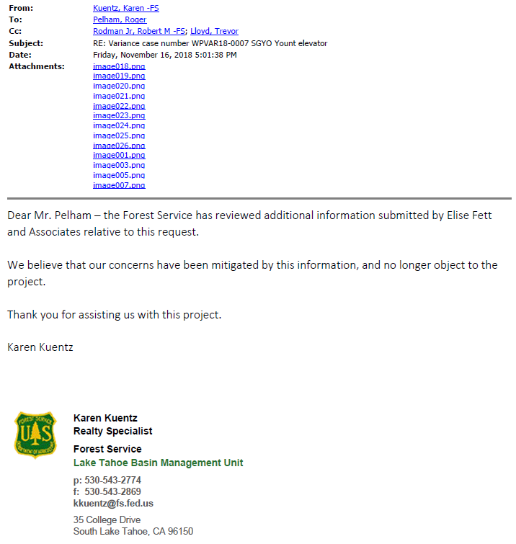

Slide 6
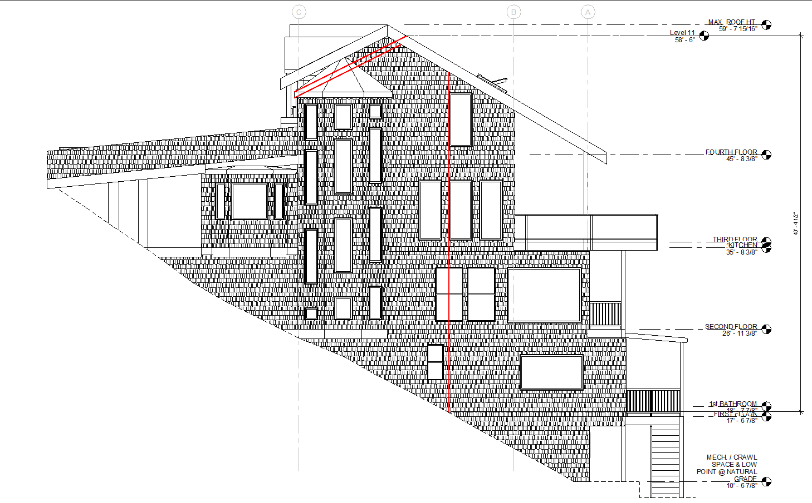
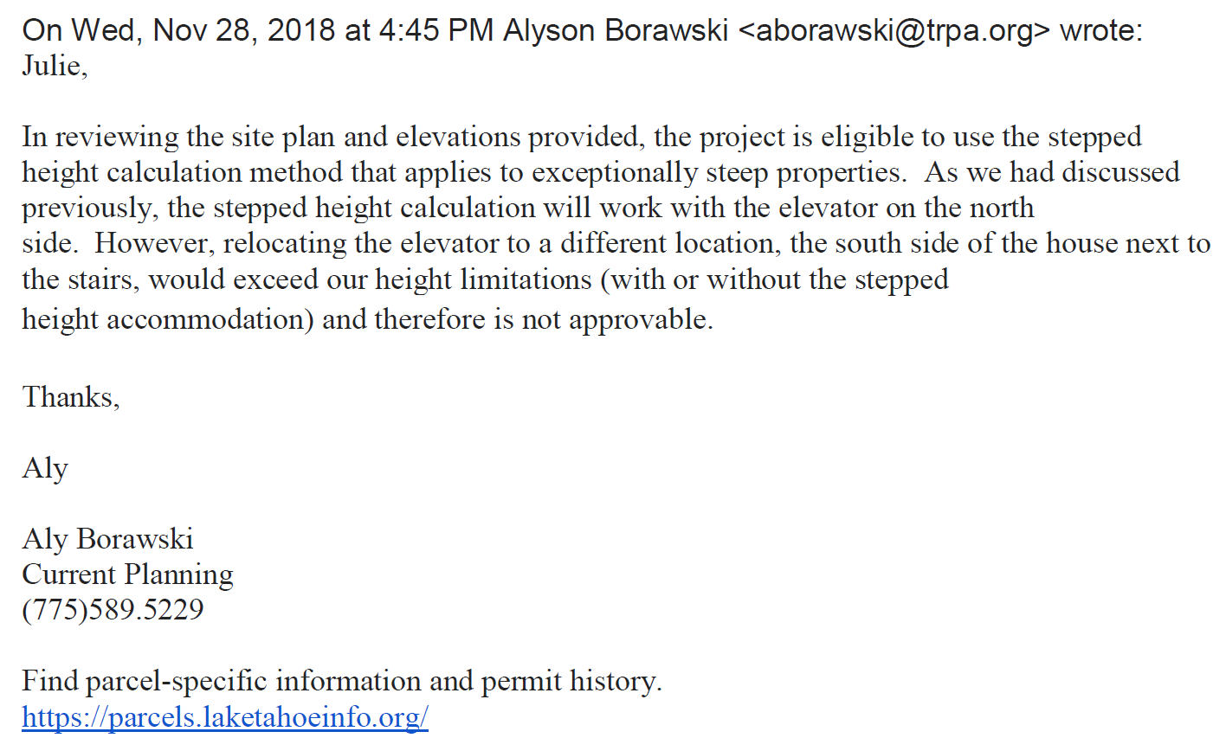
SEGMENT 1
SEGMENT 2
If elevator was located on south side, it is approx. 41’. This is 7’ higher than on the north side and above TRPA allowable height. See email from TRPA below:
SOUTH ELEVATION

Slide 7
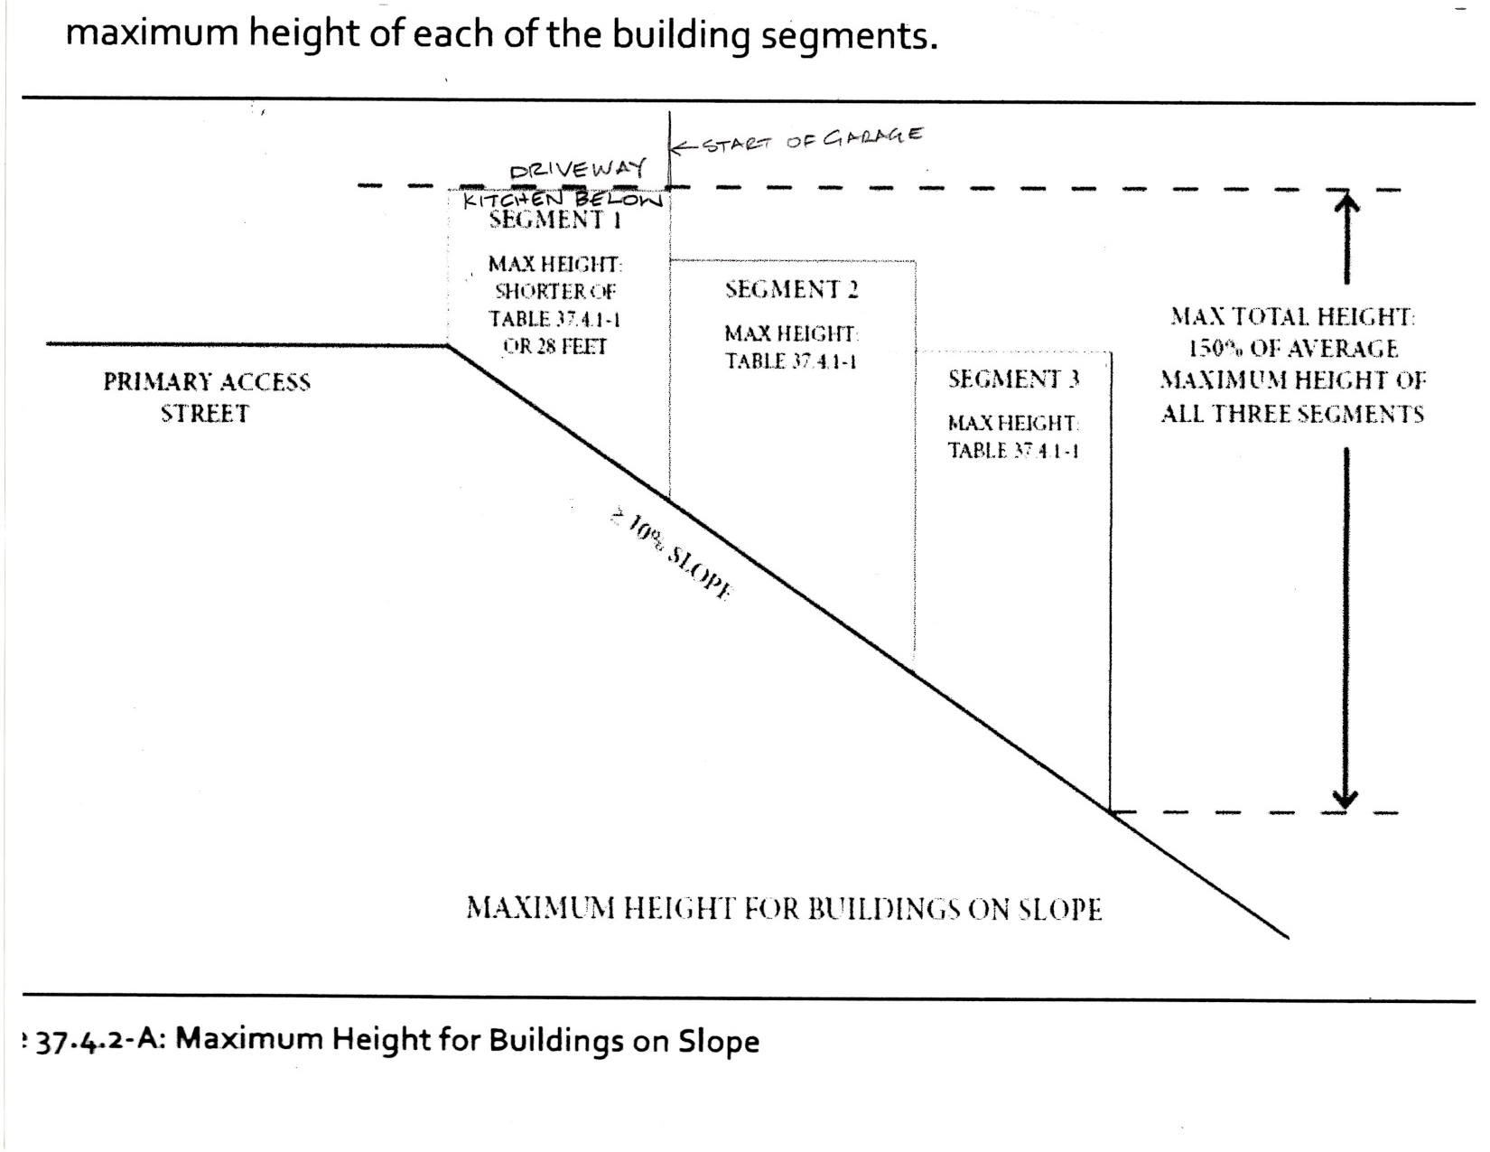
TRPA is allowing a portion of the house under the driveway to be considered as the 1st segment, even though it is not seen from the road. They are doing this to accommodate getting the elevator on the north side to work with their height requirements on this exceptionally steep lot.

Slide 8
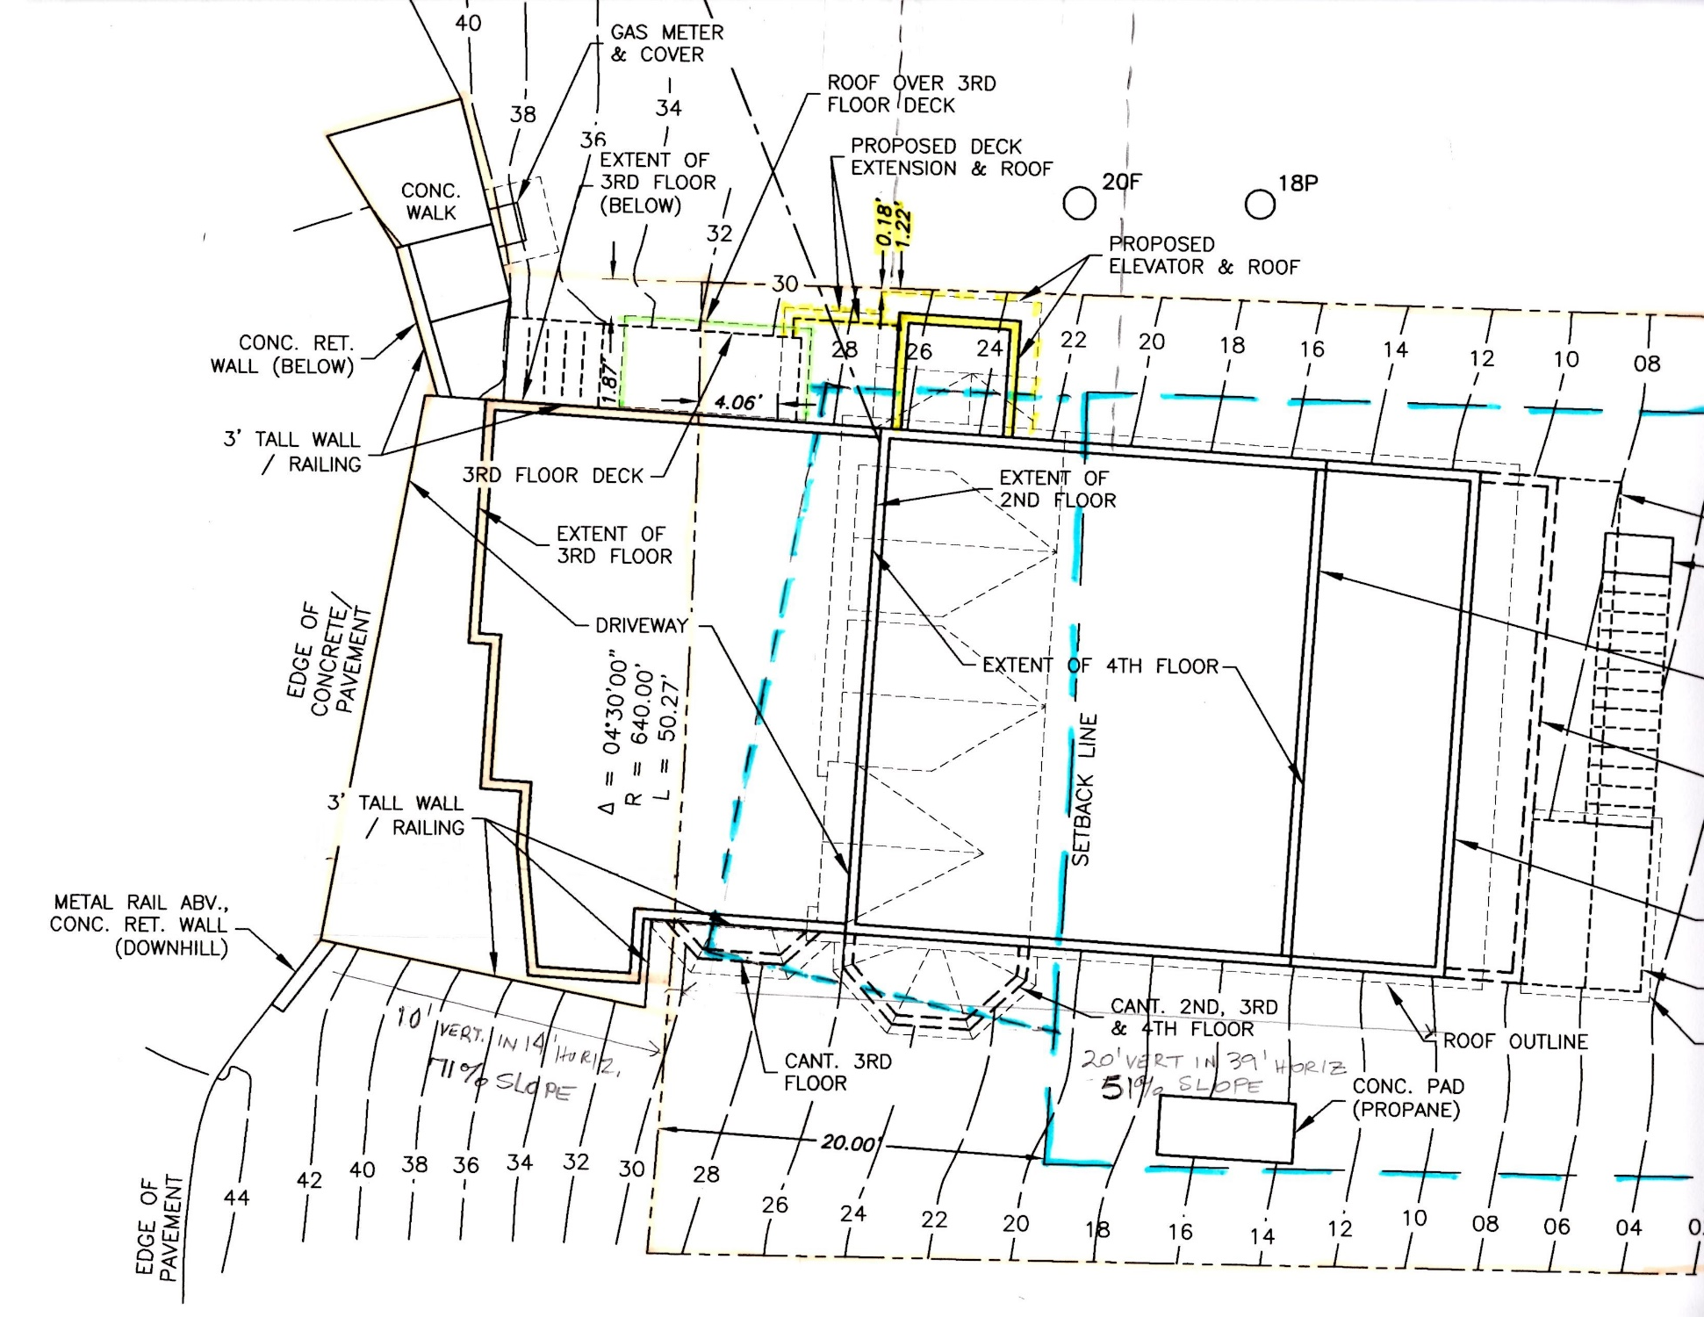
Segment 1
Segment 2
WALL IS 1.22’
FROM PL and NOT IN THE FRONT SETBACK

Slide 9
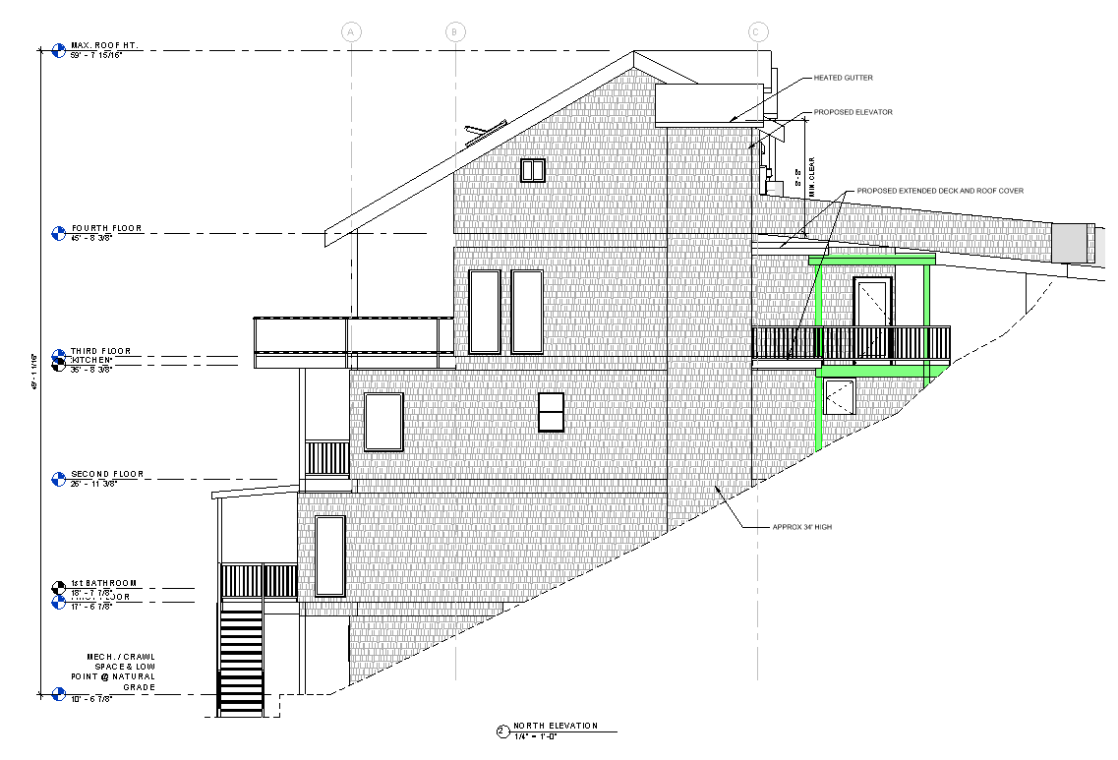

Slide 10
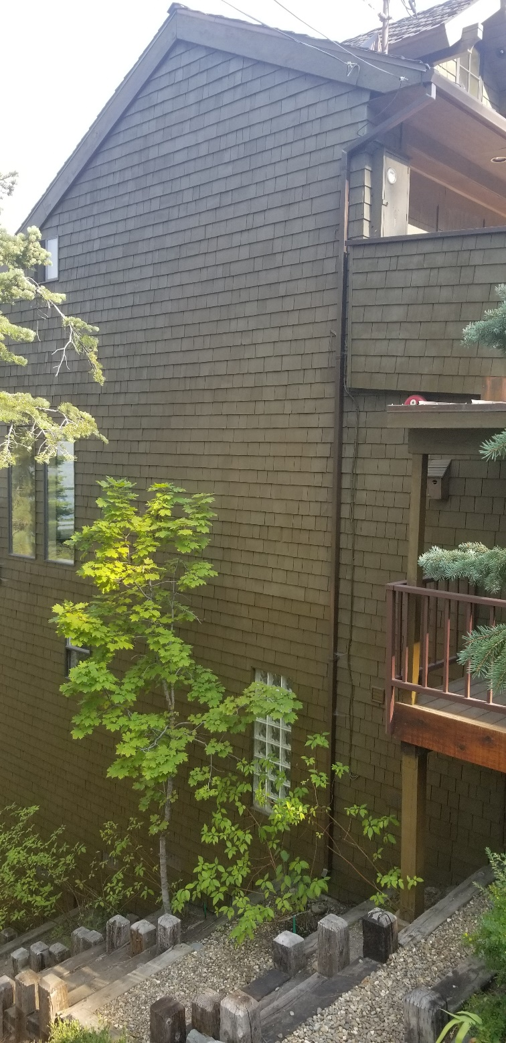
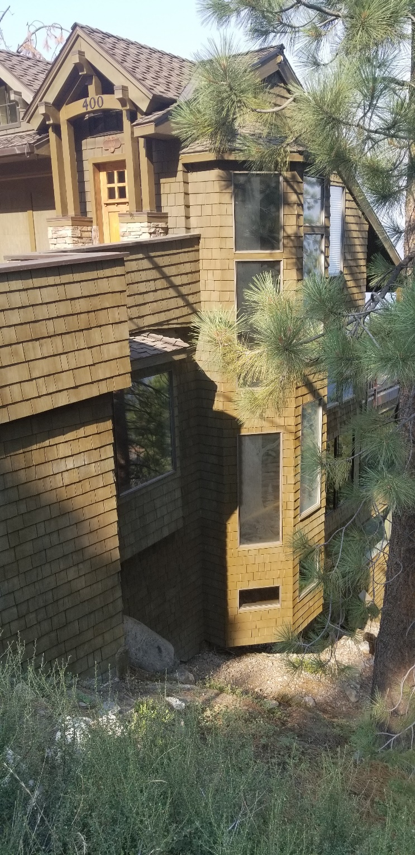
North Side
South Side

Slide 11
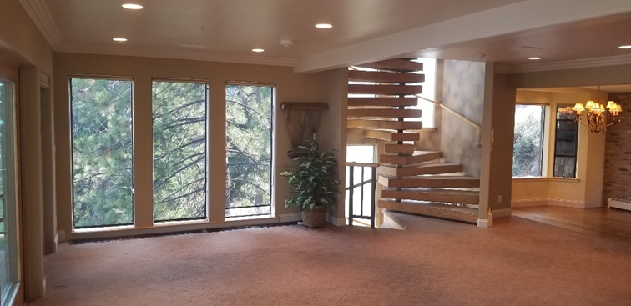
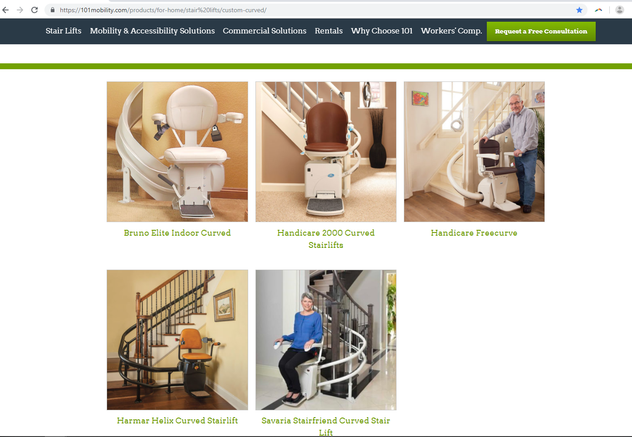
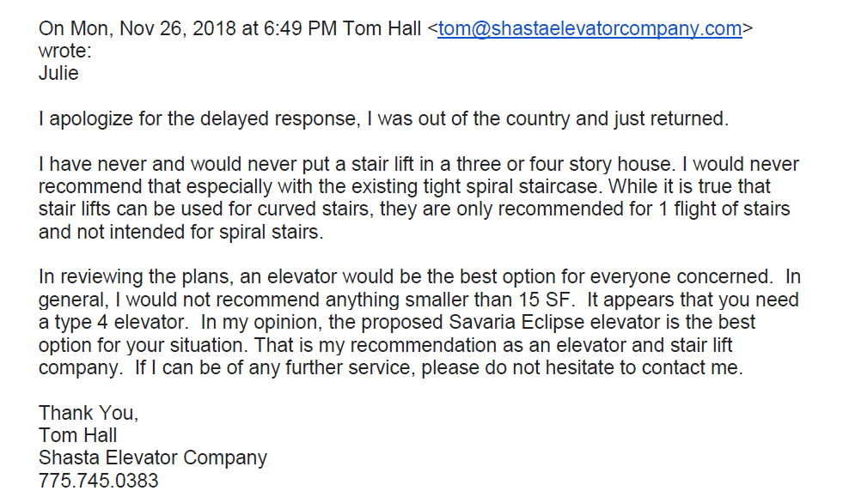
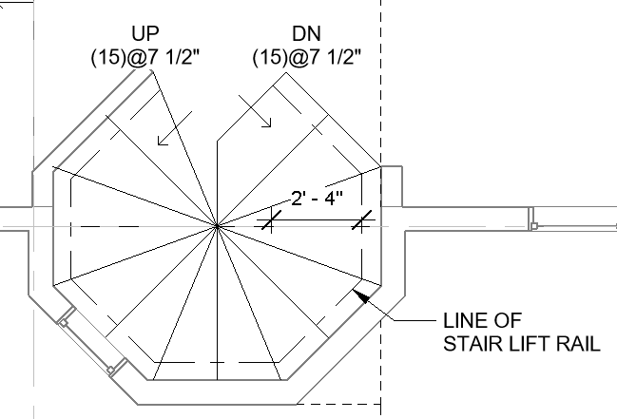
(E) Stairs
Curved stair examples from Mobility101 website
Point at which tread is less than 6” and it can not be used per building code
Doors @ 90° angles

Slide 12
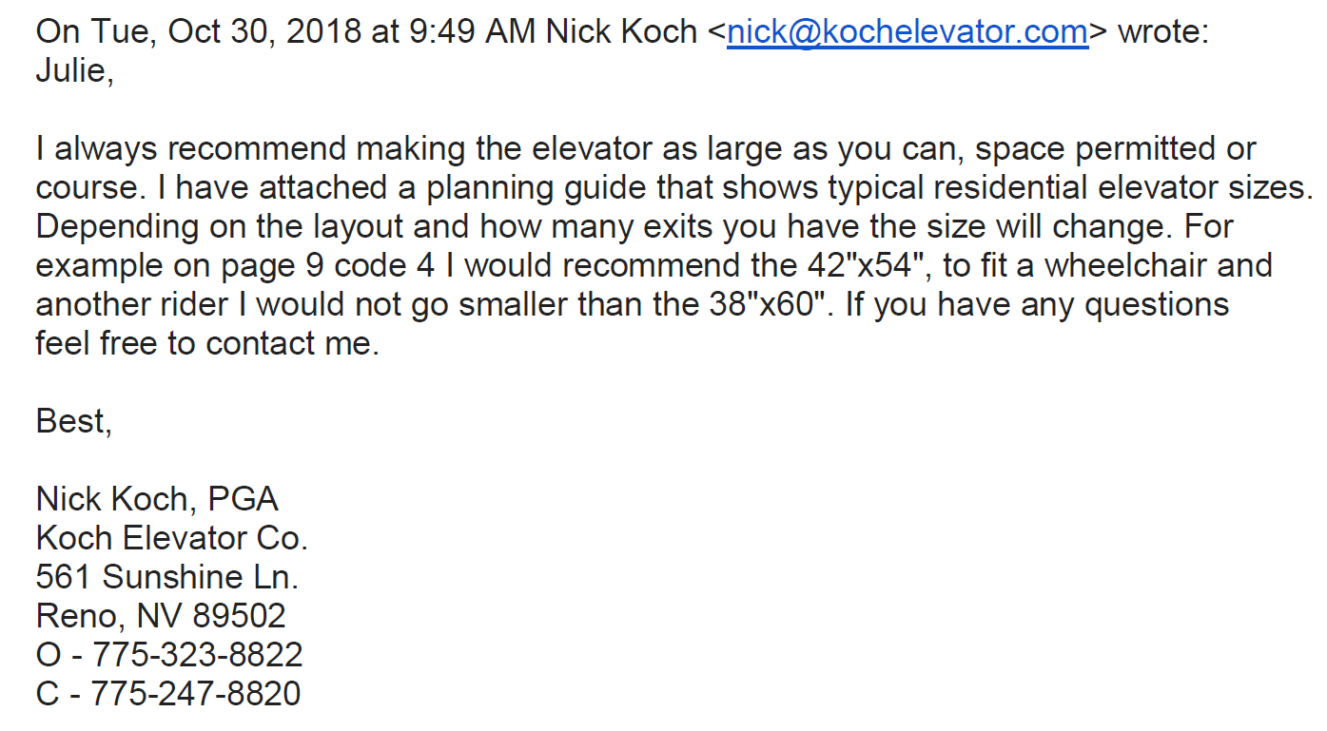
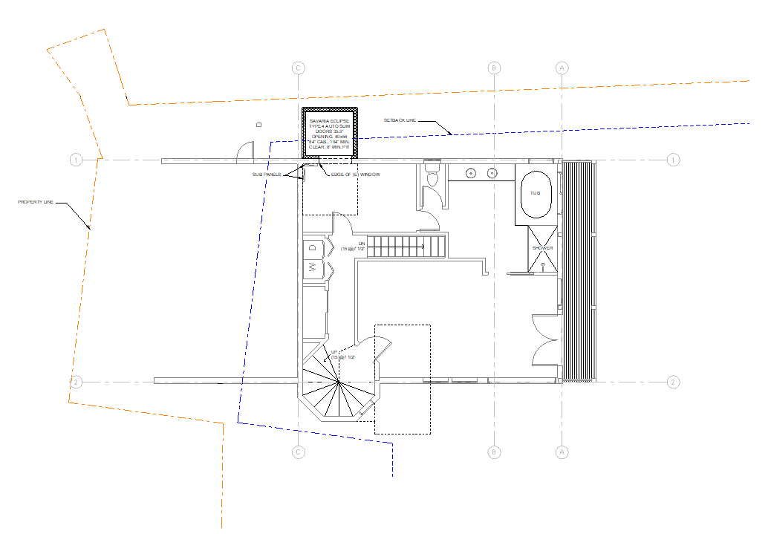
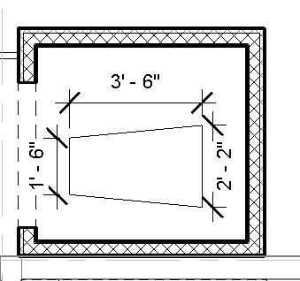
Proposed elevator cab size 40”x54” which equates to 15SF
Proposed elevator w/standard adult wheelchair footprint per ADA guidelines.
2nd Floor

Slide 13
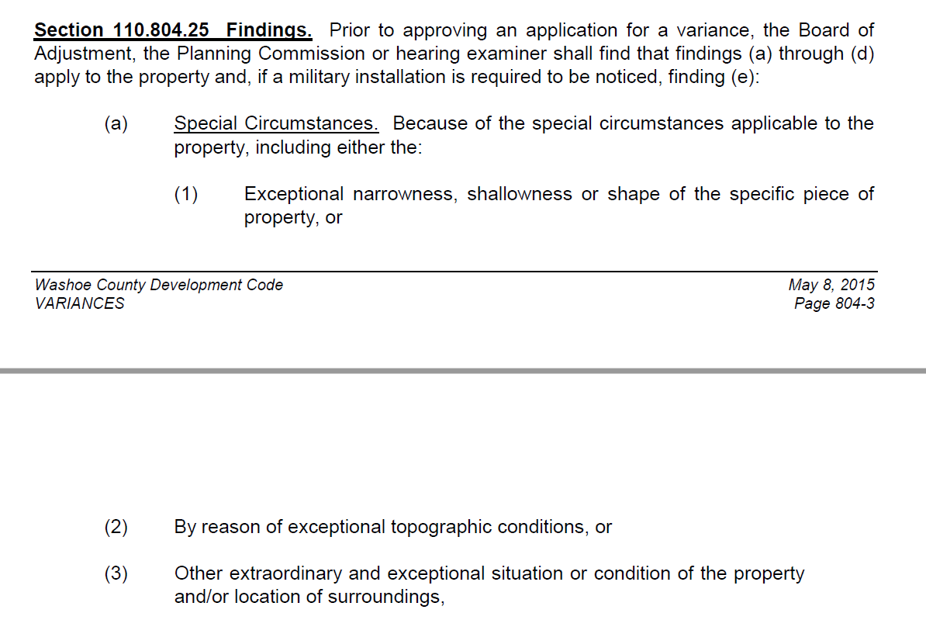
Special Circumstances
The zoning min. lot width is 60’, this lot width is 48’, 12’ less than the minimum, therefore this must be exceptional!
20% is considered steep, since Washoe Planning gives an automatic 15’ setback. The average slope of the front half of this lot is in excess of 50%. Steep slopes may be common in this area, but slopes greater than 50% are exceptional everywhere!
The exceptional steepness of the lot is evidenced by slope analysis map. In addition, note NDOT provided over 29’ into the 50’ wide right of way to accommodate the structure necessary for access on the this approximately 66% sloped area
The 51% slope on the property where the remainder of the house rests causes the existing home and an elevator shaft on the south side to exceed TRPA allowable height
The CAB considers this a hardship property and therefore unanimously recommended this project.

Slide 14
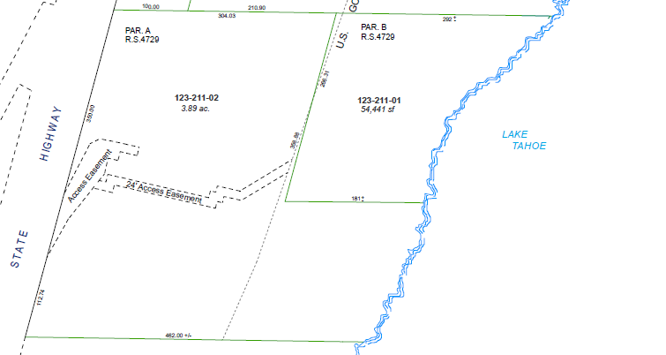
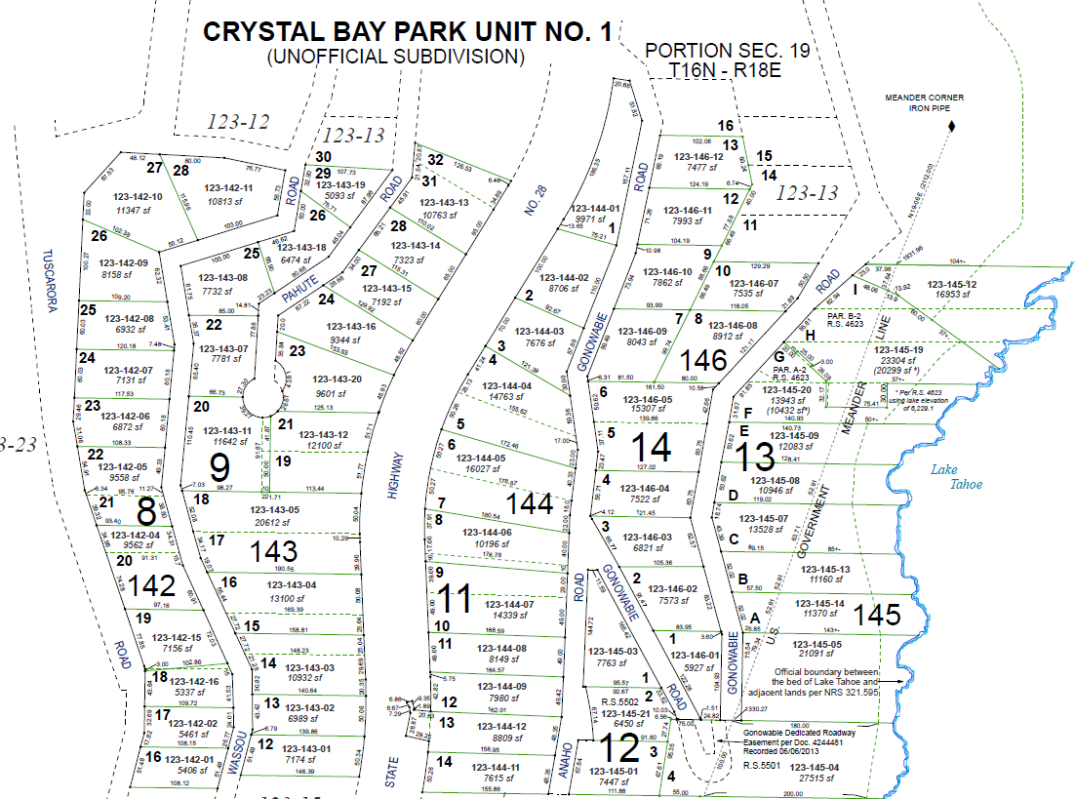
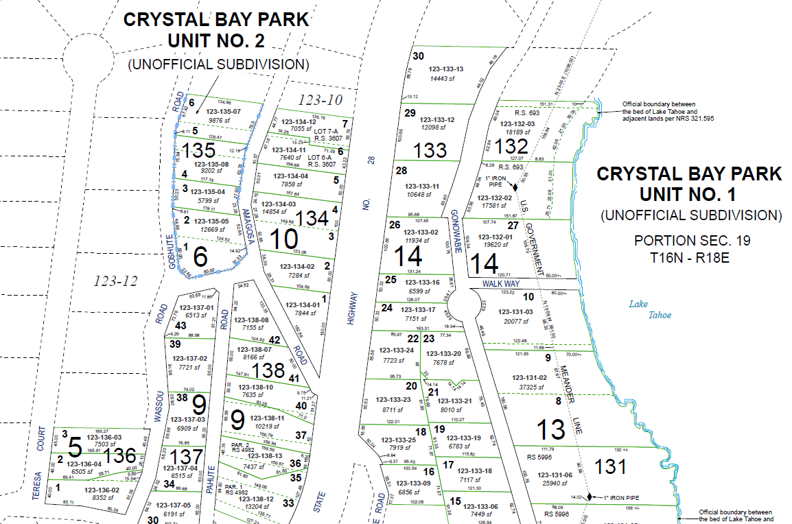
No Special Privileges
There are 3’ to 1.5’ setbacks approved at 515 and 485 Gonowabie where elevators were added and these had deep excavations next to Forest Service property, unlike what we are proposing (see VA02-034 and VA03-012)
Many of the 3&4 story homes in the area have elevators, parcels with known elevators are shown in the map below:
123-101-01
1-
03
Not pictured:
  123-097-01 on Lakeview
  123-133-13 on Gonowabie
  123-133-20 on Gonowabie
  123-132-03 on Gonowabie
  123-101-07 on Gonowabie
  123-101-08 on Gonowabie

Slide 15
No Detriment
The US Forest Service has agreed that mitigation measures will eliminate impact on their property
There is no impact to other neighbors and the addition is screened by existing foliage from both the highway and Lake Tahoe
Conclusion
When considering the change in the front property line, we are only requesting a variance to the north side setback of 1.22’ for the wall of the elevator shaft, which is a reasonable accommodation under the fair housing act
There are no other means to reasonably accommodate the addition of an elevator that is recommended by the applicant’s physician
All required findings can be met as illustrated above and on the previous slides

